Slide 1
Boston ‘Python for AI ’ Project Submission
Problem Statement : To build a vision application which can Identify the type of weed growing in the farmlands of the Karnataka Region

Slide 2
Technologies Used :-
Tensorflow
Keras
OpenCV
PIP Library :- SplitFolder
Transfer learning Models :- Vgg16 ,MobileNetV2

Slide 3
Compared both VGG16 and MobileNetv2
Comparing to MobileNetv2 VGG16 has more testing accuracy and having best accuracy

Slide 4
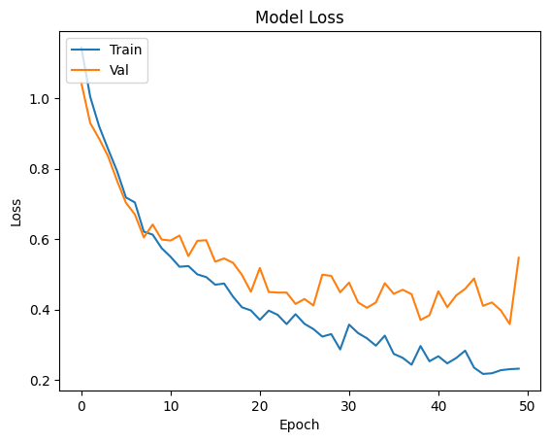
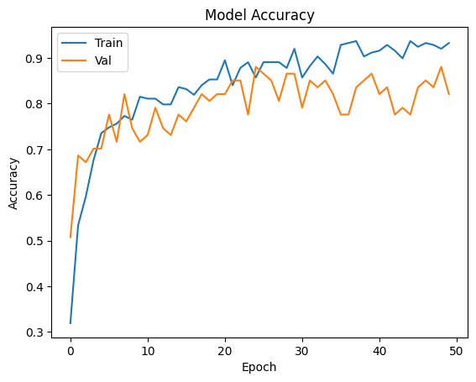
VGG16

Slide 6
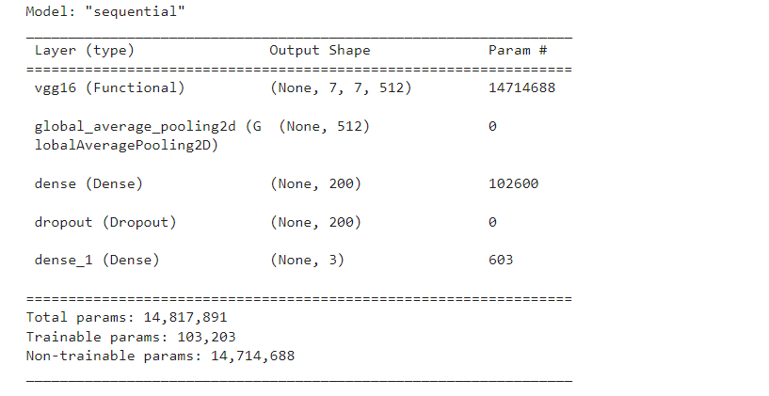

Slide 7
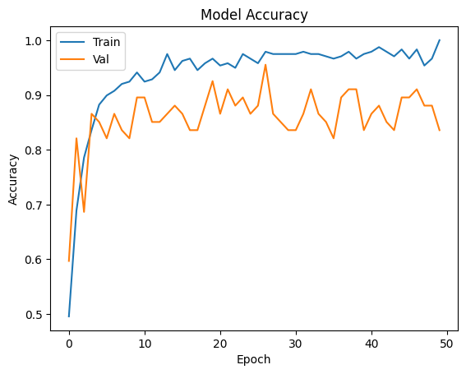
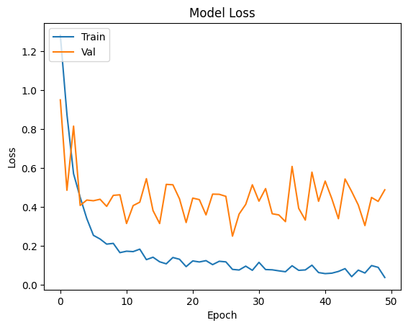
MobileNetv2

Slide 8
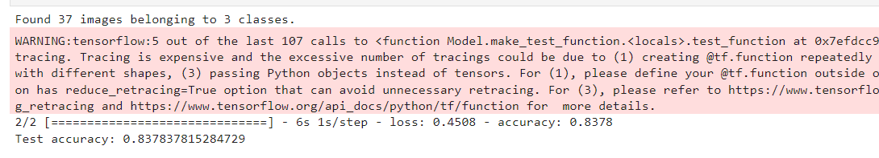

Slide 9
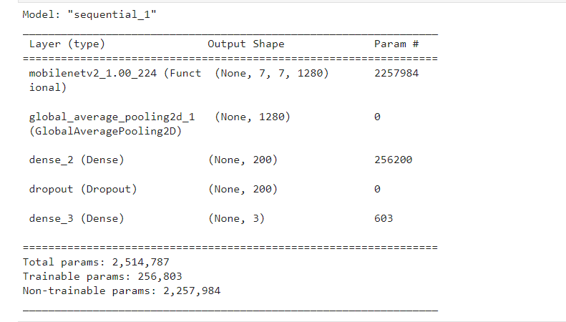

Slide 10
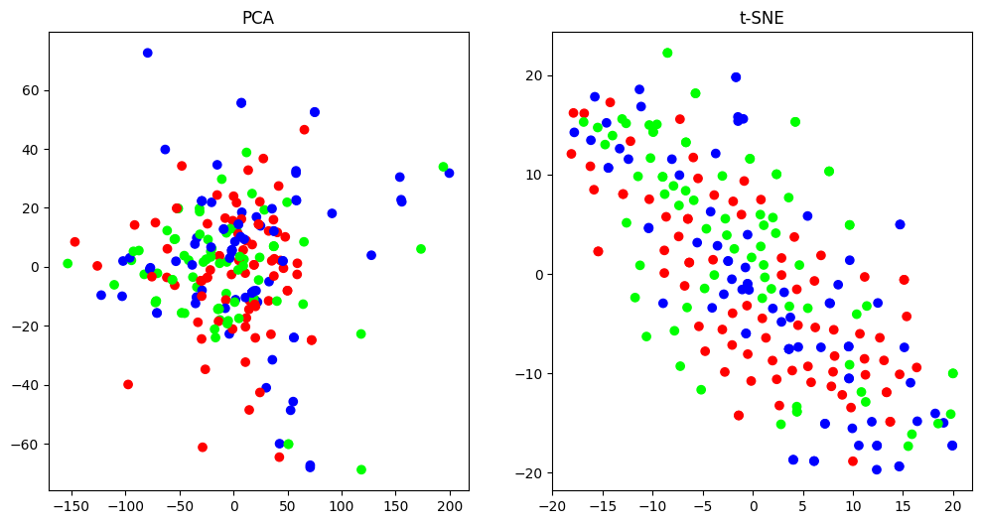
Principal Component Analysis

Slide 11
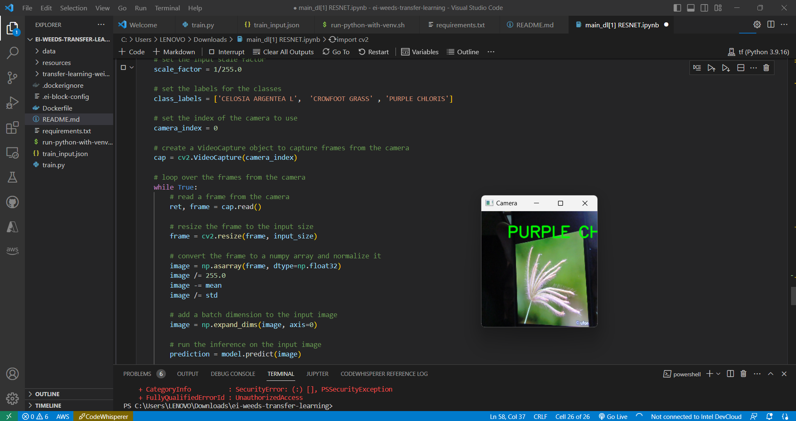
Realtime Inference of OpenCV
Purple Chloris

Slide 12
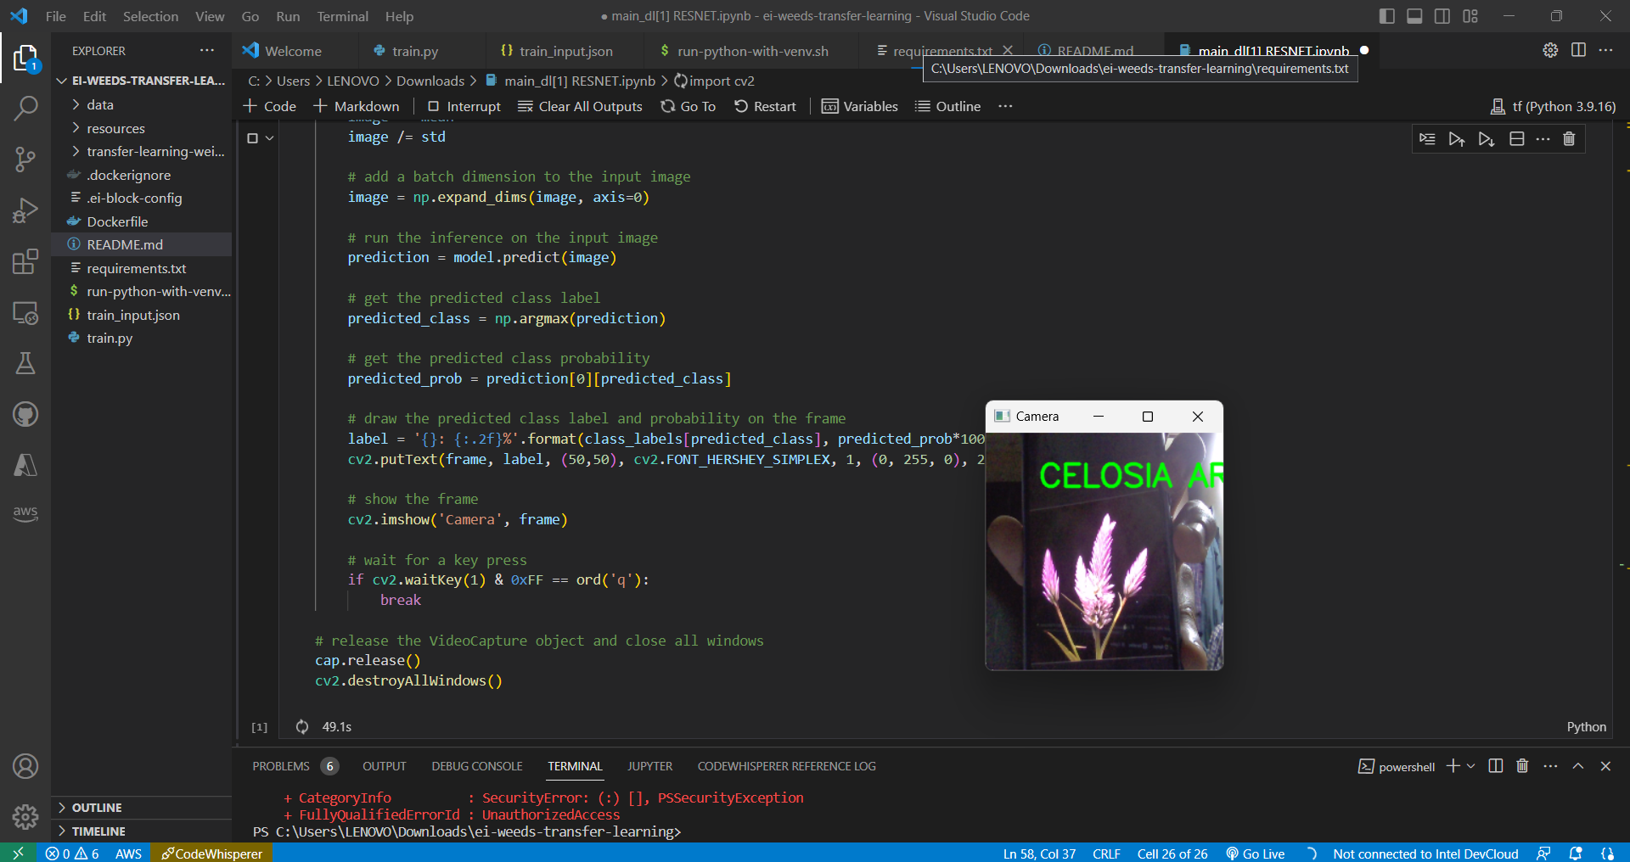
Cleosea argentia I

Slide 13
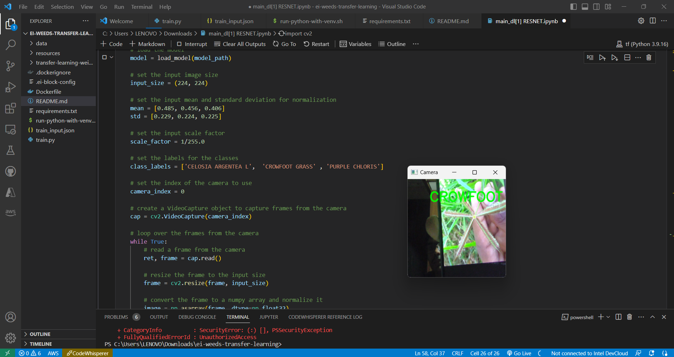
Crowfoot Grass

